Slide 1
Types and Values

Slide 2
type –
a set of elements having common computational characteristics

Slide 3
Types
int
string
Various types corresponding to tuples

Slide 4
Integer Values and Arithmetic Operations
integer values = { ~2³⁰,…,~1,0,1,…,2³⁰-1}
Note that in SML unary minus is denoted ~
arithmetic operations = { +, -, *, div, mod }

Slide 5
Integer Expressions and their Evaluation
5 - this expression cannot be simplified any further and is therefore said to be in normal form
5 + 6 → 11
5 + 6 + 7 → 11 + 7 → 18
5 + 6 * 7 → 5 + 42 → 47
(5 + 6) * 7 → 11 * 7 → 77
8 * 2 div 4 → 16 div 4 → 4
5 – 7 → ~2
The arrow symbol above denotes a computational step which is also referred to as a reduction. We say “5 + 6 reduces to 11”.

Slide 6
Arithmetic Operations
Operator | Expression | Normal Form
+ | 5 + 4 | 9
- | 4 - 5 | ~1
* | 4 * 5 | 20
div | 17 div 5 | 3
mod | 17 mod 5 | 2

Slide 7
Expressions and Values and Types – Oh my!
Expression | Result
5 + 4 | 9 : int
4 - 5 | ~1 : int
4 * 5 | 20 : int
17 div 5 | 3 : int
17 mod 5 | 2 : int

Slide 8
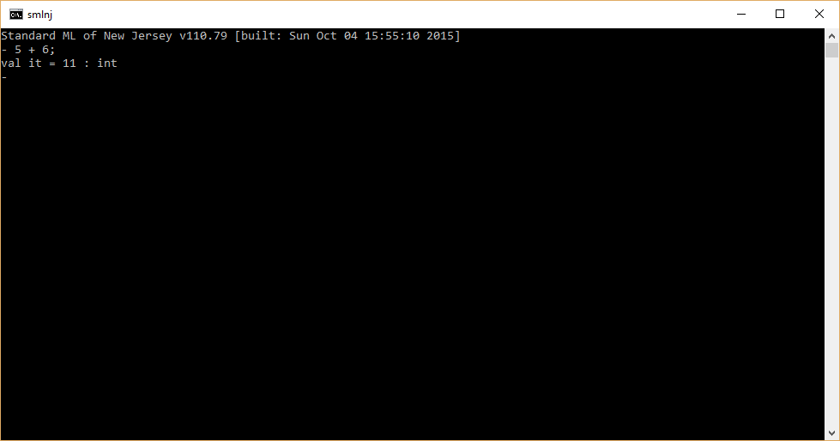
SML Interpreter

Slide 9
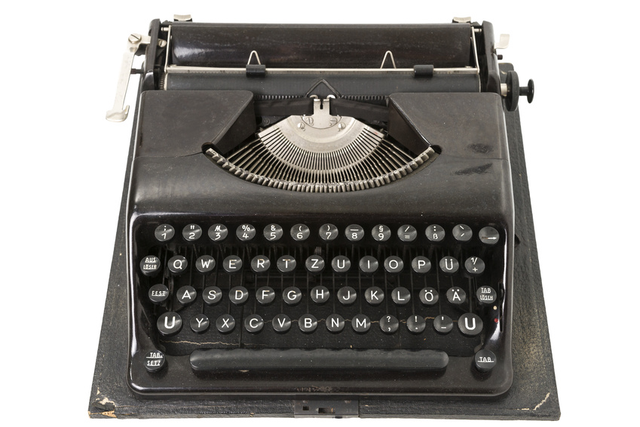
String values and Operations
string values = { “”, “a”, …, some large string }
string operation = { ^ }

Slide 10
String Expressions and their Evaluation
“hello” ^ “ world” → “hello world”
“see” ^ “ spot” ^ “ run” → “see spot” ^ “ run” → “see spot run”

Slide 11
String Operations
Operator | Expression | Normal Form
^ | “hello” ^ “ world” | “hello world”

Slide 12
Expressions and values and types
Expression | Result
“hello” ^ “ world” | “hello world” : string

Slide 13
Tuple Expressions and their Evaluation
a tuple value is a comma-separated sequence of two or more values enclosed in parenthesis.
a tuple is a comma-separated sequence of two or more expressions enclosed in parenthesis.
a tuple is reduced to a tuple value by reducing its expressions from left to right (e.g., the left most expression is reduce first, and so on).
An expression e enclosed in parenthesis reduces to e.
(e) → e
An expression consisting of parenthesis that enclose nothing denotes a value that is called unit.

Slide 14
Evaluation of Tuples
Expression | Reduction Sequence | Normal Form
(5 + 4, 1 + 2) | → (9, 1 + 2) → (9,3) | (9,3)
(“hi” ^ “ world”, 2 * 3) | → (“hi world”, 2 * 3) → (“hi world”, 6) | (“hi world”, 6)
(4,5) |  | (4,5)
(4, 2 + 3) | → (4,5) | (4,5)
(1+1, 3, 5 + 3) | → (2, 3, 5 + 3) → (2, 3, 8) | (2,3,8)

Slide 15
Tuple Types
Expression | Normal Form | Type
(5 + 4, 1 + 2) | (9,3) | int * int
(“hi” ^ “ world”, 2 * 3) | (“hi world”, 6) | string * int
(4,5) | (4,5) | int * int
(1+1, 3, 5 + 3) | (2,3,8) | int * int * int
Remark: In the context of types, the * symbol denotes the Cartesian product.
Special Cases
Expression | Normal Form | Type
() | () | unit
(2 * 3) | (6) | int

Slide 16
Nested Tuples
A tuple is a kind of expression.
A tuple consists of a comma separated sequence of expressions.
Therefore, a tuple can contain a tuple – which can contain another tuple and so on!
(6 * 2, (1+1, 5), “hello”) → (12, (1+1, 5), “hello”) → (12, (2, 5), “hello”)
(12, (2, 5), “hello”) : int * (int * int) * string

Slide 17
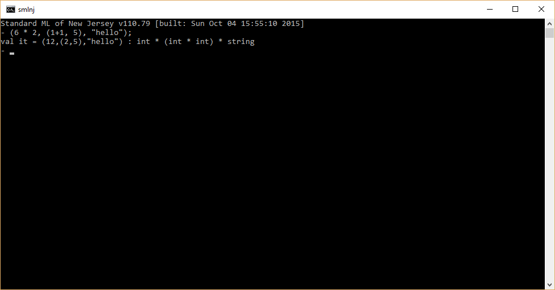
SML Interpreter

Slide 18
Variables, Names, and Identifiers

Slide 19
Variables
In SML, a variable is a language construct which can be associated with (i.e., bound to) a value and a type.
A variable is bound to the result of a computation (i.e., its normal form).
In books on programming languages, the terms variable, name, and identifier (id) are often used loosely in an interchangeable manner.
Conceptually, a variable represents a place where values (and types) can be stored.
An identifier is how the value in a place can be referenced within a program.

Slide 20
Variables
Variable | Name/Id | Value | Type
x | x | 5 | int
y | y | “hello” | string

Slide 21
Function Names
In Bricklayer Level 2, we are interested in declaring functions.
Part of a function declaration involves giving a name to the function.
The understanding of a function can be significantly improved by naming it appropriately. In order to do this, it helps to have an understanding of the rules constraining the choice of names (aka identifiers).

Slide 22
Identifiers
We will define an identifier as a sequence of characters beginning with an alphabetic character (e.g., a-z or A-Z) followed by zero or more alphanumeric characters (e.g., a-z, A-Z, or 0-9) or underscores.
Remark: this definition of identifier is a subset of the set of legal SML identifiers.

Slide 23
Tokens and Spaces

Slide 24
The Structure of a Book
A sequence of characters (including blank characters).
A sequence of words and punctuation symbols.
A sequence of sentences.
A sequence of paragraphs.
A sequence of chapters.
Note that a chapter consists of a sequence of paragraphs, and a paragraph consists of a sequence of sentences.

Slide 25
SML programs also have a Structure
An SML program consists of a sequence of characters.
An SML program contains values, identifiers, and reserved symbols.
An SML program contains expressions (which define computations to be performed).
A Bricklayer function call is a kind of expression.
An SML program contains declarations.
open Level_1 is an example of a declaration.
For now, we consider a Bricklayer program to consist of a sequence of declarations followed by a sequence of expressions.

Slide 26
Lexical Analysis
A sequence of characters can be converted into a sequence of tokens through a process called lexical analysis.
Tokens correspond to values, identifiers, and reserved symbols.
During lexical analysis white space is discarded.

Slide 27
put2D_4x2_BLUE(10, 1 + 1);
Token | Classification | Comment
put2D_2x4_BLUE | Identifier | Bricklayer function name
( | Reserved symbol | Delimiter - left parenthesis
10 | Integer | value
, | Reserved symbol | Delimiter - comma
1 | Integer | value
+ | Reserved symbol | primitive arithmetic operation
1 | Integer | value
) | Reserved symbol | Delimiter – right parenthesis
; | Reserved symbol | Sequential composition – semi-colon

Slide 28
Type Systems

Slide 29
Type Systems
In a strongly typed programming language, a type system classifies expressions according to their type (e.g., int, string).
Most (but not all) of this analysis can be done prior to executing a program (i.e., at runtime).
Analysis that is done prior to program execution is called static analysis.
Analysis (or checks) that are performed during runtime is called dynamic analysis.

Slide 30
int
8 div 4
“hi” ^ “world”
5+4
string
7
“hello”

Slide 31
8 div 0
undefined
“hello” ^ 7
“hi” * 5
In this context, an undefined computation is also called an error.

Slide 32
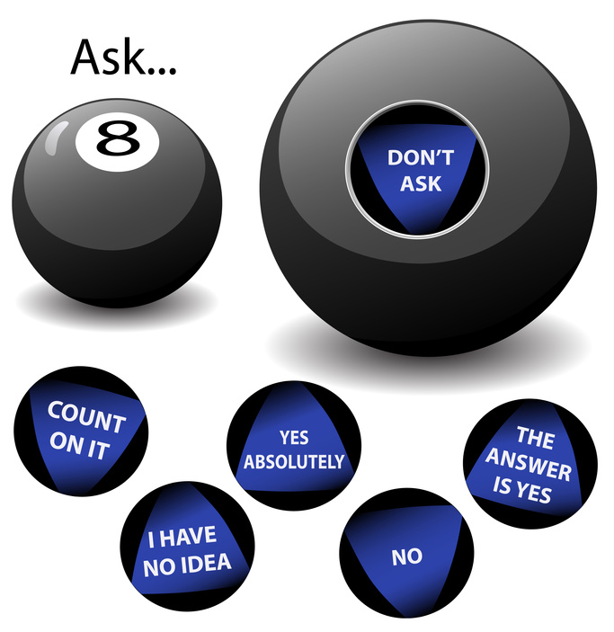
error
8 div 0
?
8 div x
int

Slide 33
Limits of Static Analysis
In general, determining the value of an expression lies beyond the limits of static analysis.
Values are determined during program execution (i.e., at runtime).
To be complete, some checks in a type system must be performed at runtime. This slows down program execution.

